Slide 1
Benchmarking Learned and LSM Indexes for Data Sortedness
Aneesh Raman
Andy Huynh
Jinqi Lu
Manos Athanassoulis

Slide 2

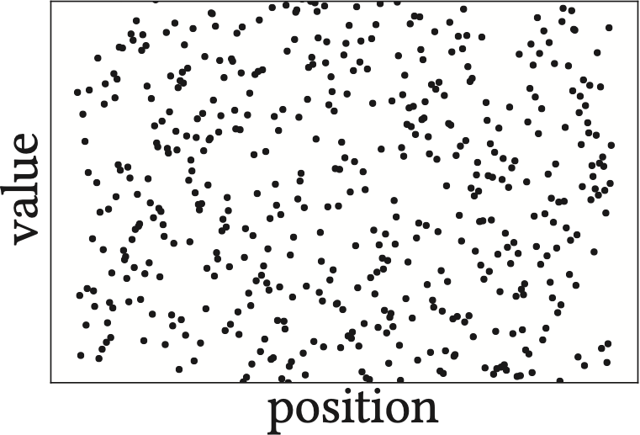
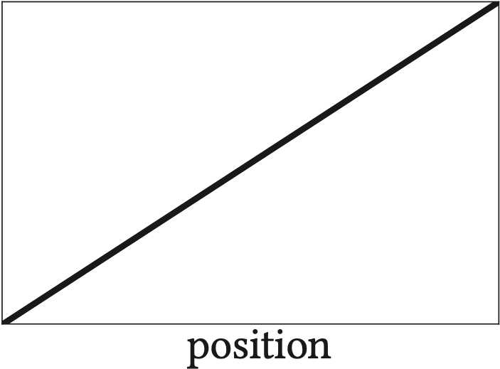
Indexes in Databases
organize
data
efficient
queries
unstructured
data
structured
data
The process of inducing sortedness to an otherwise unsorted data collection
Notes:
The reorganization of data to support efficient queries comes at a cost of space and write amplification - i.e., needed to build and maintain the index data structure. In that respect, indexing can be perceived as inducing sortedness or establishing complete order to an otherwise unsorted data collection.
If you say adding structure, make sure you explain sortedness is the structure. Trash right side.

Slide 3


What if data already has some structure?

Slide 4

What if data already has some structure?
Value
Value
Position (time)
Position (time)
Near-sorted data

Slide 5
What if data already has some structure?
⩬
treated same as
unstructured data!
Value
Value
Position (time)
Position (time)
Near-sorted data

Slide 6
Irrespective of Sortedness, Same Ingestion Performance
Standard ingestion
Ingestion cost
Scrambled
Increasing data sortedness
Sorted
Notes:
Let us take an example of a b-tree to offer better context. We have the faster bulk loading technique and the standard ingestion (i.e., one at a time). What we expect is to follow the blue line, wherein we perform less work as data sortedness increases.
Say that we want every index paper to have such a graph evaluating with sortedness.
Ask a question... How do we do this?

Slide 7
Are There Faster Alternatives?
Standard ingestion
Ingestion cost
Bulk loading requires all data a priori!
Bulk loading
Scrambled
Increasing data sortedness
Sorted
Notes:
Let us take an example of a b-tree to offer better context. We have the faster bulk loading technique and the standard ingestion (i.e., one at a time). What we expect is to follow the blue line, wherein we perform less work as data sortedness increases.
Say that we want every index paper to have such a graph evaluating with sortedness.
Ask a question... How do we do this?

Slide 8
Ideally, Higher Sortedness Should Lead to Faster Ingestion
Standard ingestion
Pay less cost as data
Ingestion cost
Ideal ingestion
becomes more sorted
Bulk loading
Scrambled
Increasing data sortedness
Sorted
Notes:
Let us take an example of a b-tree to offer better context. We have the faster bulk loading technique and the standard ingestion (i.e., one at a time). What we expect is to follow the blue line, wherein we perform less work as data sortedness increases.
Say that we want every index paper to have such a graph evaluating with sortedness.
Ask a question... How do we do this?

Slide 9



Near-Sorted Data is Frequently Found
Time Series
Stock market
efficient reads
fast writes
⋈
classical indexes carry redundant effort!
Join/query
Notes:
flip order here

Slide 10




Prior Work Focuses on Classical Indexes
✓
In-memory buffering
BENCHMARK
✓
Opportunistic bulk loading
B⁺-tree
✓
Sortedness-adaptiveness
...
✓
Better memory utilization

Slide 11
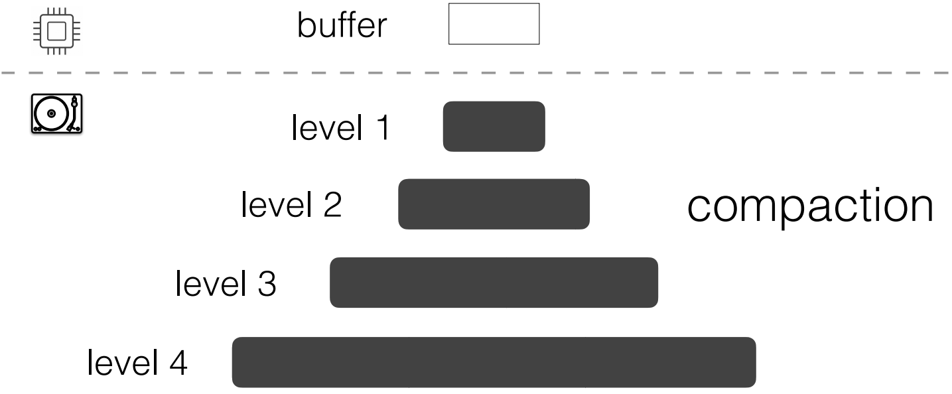
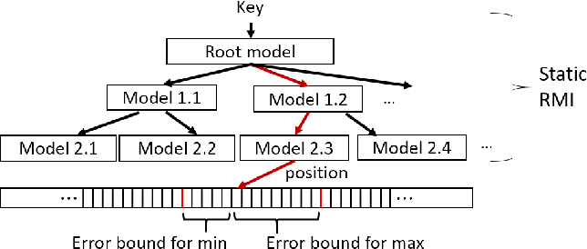
Prior Work Focuses on Classical Indexes
BENCHMARK
B⁺-tree
...
Other Index Designs?

Slide 12
Agenda
Introduction
Vision
Background on Index Designs
Sortedness Metrics & Evaluation Framework
Benchmarking Results

Slide 13
ALEX: An Updatable Learned Index
M
Root node
model
M
M
M
M
…
…
M
Adaptive
Recursive Model Index (RMI)
M
M
M
…
…
M
M
M
M
Data node
Ding, et.al [SIGMOD 2020]

Slide 14
ALEX: An Updatable Learned Index
M
Root node
model
M
M
M
M
…
…
M
Adaptive
Recursive Model Index (RMI)
M
M
M
…
…
M
M
M
key
M
gap
Gapped array
Data node

Slide 15
Lookups in ALEX
M
Root node
model
M
M
M
M
…
…
M
Adaptive
Recursive Model Index (RMI)
M
M
M
…
…
M
M
M
M
Exponential search
Data node

Slide 16
Insertions in ALEX
M
Root node
model
M
M
M
M
…
…
M
Adaptive
Recursive Model Index (RMI)
M
M
M
…
…
M
M
M
✓
model based insertions
M
✓
gapped array uses fewer shifts
Exponential search
✓
exponential search scales
with error size
Data node

Slide 17

Insertions in ALEX
M
Root node
model
M
M
M
M
Inserting pre-structured data…
…
…
M
Adaptive
Recursive Model Index (RMI)
M
M
M
…
…
M
M
like a “normal” array
M
✓
model based insertions
gaps are infrequent
M
✓
faster exp. Search!
gapped array uses fewer shifts
Exponential search
✓
exponential search scales
with error size
Data node

Slide 18
LIPP: An Updatable Learned Index with Precise Positions
Kernalized linear model M
M
Array of entries ε
Legend
null/empty
Bit vector of entry types
data
M
M
…
node
M
M
M
…
Wu, et.al [VLDB 2021]

Slide 19
Lookups in LIPP
key k
Kernalized linear model M
M
Array of entries ε
Legend
null/empty
Bit vector of entry types
data
M
M
…
node
M
M
M
…

Slide 20
Insertions in LIPP
insert (k,v)
Kernalized linear model M
M
Array of entries ε
Legend
null/empty
Bit vector of entry types
data
M
M
…
node
✓
model based insertions
M
M
M
…

Slide 21
Insertions in LIPP
insert (k,v)
Kernalized linear model M
M
Array of entries ε
Legend
null/empty
Bit vector of entry types
data
M
M
…
node
✓
model based insertions
M
M
M
M
✓
create smaller nodes
for conflicts
…
✓
no shifting necessary

Slide 22

Log Structured Merge Trees (LSM-trees)
buffer
level 1

Slide 23
Log Structured Merge Trees (LSM-trees)
sort + flush
buffer
level 1

Slide 24
Log Structured Merge Trees (LSM-trees)
sort + flush
buffer
level 1
sorted run
size ratio T

Slide 25
Log Structured Merge Trees (LSM-trees)
level 0/
buffer
level 1
size ratio T
level 2
level 3
Sort-merging is called compaction

Slide 26

Partial Compactions in RocksDB
level 0/
buffer
level 1
capacity
size ratio T
level 2
level 3
Compaction performed at the granularity of files

Slide 27
Partial Compactions in RocksDB
level 0/
buffer
level 1
size ratio T
level 2
level 3
Compaction performed at the granularity of files

Slide 28
Partial Compactions in RocksDB
level 0/
buffer
level 1
size ratio T
level 2
level 3
Compaction performed at the granularity of files

Slide 29
Partial Compactions in RocksDB
level 0/
buffer
level 1
pick subset of files
size ratio T
level 2
level 3
Compaction performed at the granularity of files

Slide 30
Partial Compactions in RocksDB
level 0/
buffer
level 1
pick subset of files
size ratio T
level 2
level 3
Compaction performed at the granularity of files

Slide 31
Trivial Moves
suppose file_2 is chosen for compaction
2
1
2
level 1
5
30
30
40
20
40
3
4
5
level 2
1
10
11
26
50
60
compaction would re-write file_2 in level_2
BUT, file_2 has no overlapping keys in level_2

Slide 32
Trivial Moves
suppose file_2 is chosen for compaction
1
2
level 1
5
20
30
40
3
4
2
5
level 2
1
10
11
26
30
40
50
60
compaction would re-write file_2 in level_2
file_2 is actually moved without compaction!
Trivial Moves saves wasteful effort!

Slide 33
Agenda
Introduction
Vision
Background on Index Designs
Sortedness Metrics & Evaluation Framework
Benchmarking Results

Slide 34
Quantifying Data Sortedness
Metric | Description
Inversions | # pairs in incorrect order
Runs | # increasing contiguous subsequences
Exchanges | least # swaps needed to establish total order
Notes:
These legacy metrics however carry some drawbacks that make them unsuitable for using in the benchmark.

Slide 35
Quantifying Data Sortedness
Metric | Description
Inversions | # pairs in incorrect order
Runs | # increasing contiguous subsequences
Exchanges | least # swaps needed to establish total order
6 | 7 | 8 | 9 | 10 | 1 | 2 | 3 | 4 | 5
Notes:
These legacy metrics however carry some drawbacks that make them unsuitable for using in the benchmark.

Slide 36
Quantifying Data Sortedness
Metric | Description
Inversions | # pairs in incorrect order
Runs | # increasing contiguous subsequences
Exchanges | least # swaps needed to establish total order
⛔️
✅
⛔️
6 | 7 | 8 | 9 | 10 | 1 | 2 | 3 | 4 | 5
global disorder
Notes:
It turns out that inputs of such type will have quadratic number of inversions.

Slide 37
Quantifying Data Sortedness
Metric | Description
Inversions | # pairs in incorrect order
Runs | # increasing contiguous subsequences
Exchanges | least # swaps needed to establish total order
2 | 1 | 4 | 3 | 6 | 5 | 8 | 7 | 10 | 9
Notes:
These legacy metrics however carry some drawbacks that make them unsuitable for using in the benchmark.

Slide 38
Quantifying Data Sortedness
Metric | Description
Inversions | # pairs in incorrect order
Runs | # increasing contiguous subsequences
Exchanges | least # swaps needed to establish total order
Metric | Description
Inversions | # pairs in incorrect order
Runs | # increasing contiguous subsequences
Exchanges | least # swaps needed to establish total order
✅
⛔️
✅
2 | 1 | 4 | 3 | 6 | 5 | 8 | 7 | 10 | 9
local disorder
Notes:
While this is something that can be well handled by inversions, it turns out that runs do not handle such cases well.

Slide 39
(K, L)-Sortedness Metric
BENCHMARK
#. unordered entries
= K
1 | 8 | 3 | 4 | 5 | 6 | 7 | 2 | 9 | 10
max. displacement among unordered entries
= L
inspired by Ben-Moshe, et.al [ICDT 2011]
Notes:
The combination of K and L not only captures the global and local disorders that may arise, but also underlines the effort to establish total order in the data collection.

Slide 40




Framework
Data generation
Index initialization
Workload execution
Results

Slide 41
Framework
Data generation
Index initialization
Workload execution
Results
BoDS
data generator

Slide 42
Framework
Data generation
Index initialization
Workload execution
Results
BoDS
data generator
ALEX
LIPP
LSM-tree

Slide 43
Framework
read, write or read+write
Data generation
Index initialization
Workload execution
Results
BoDS
data generator
ALEX
LIPP
LSM-tree

Slide 44
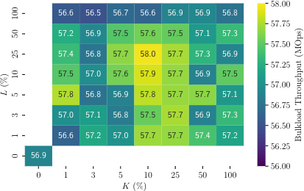
Framework
read, write or read+write
Data generation
Index initialization
Workload execution
Results
BoDS
data generator
ALEX
LIPP
LSM-tree

Slide 45
Experimental Setup
Server Setup
2 Intel Xeon Gold 6230 processors
384GB main memory
1TB Dell P4510 NVMe drive
CentOS 7.9.2009
Default page size = 4KB
Index Setup
ALEX: Node size = 16MB (default setting)
LIPP: Bitmap width = 1 Byte (default setting)
RocksDB:
kCompactionStyleLevel & kMinOverlappingRatio
Buffer size = 40MB; Size ratio = 4

Slide 46
Reading the Results
read, write or read+write
Workload execution

Slide 47
Reading the Results
read, write or read+write
Evaluation metric
increasing % max. displacement
Workload execution
increasing % out-of-order entries

Slide 48
Let’s talk about the B⁺-tree
B⁺-tree always performs index traversals
Why higher throughput with high sortedness?
✓
improved performance due to caching effects
However, this is not the ideal performance…

Slide 49
Let’s talk about the B⁺-tree
Preloading performance
Bulk loading is at least 8x faster!
Indexing for Near-Sorted Data [ICDE ‘23]

Slide 50
Getting back to Learned Indexes and LSM-trees…
sortedness-responsiveness ≠ sortedness-adaptivity
Performance can change with differently sorted data, but is it optimal?

Slide 51
ALEX Performs Best With High Data Sortedness!
higher throughput L low or moderate
✓
High sortedness ⇒dense runs + terminal gaps
✓
L (%)
Less shifting required
Bulk loading is at least 2x faster!
✓
Faster exponential search!
K (%)
higher throughput when K and L are low
Best throughput

Slide 52
LIPP Performs Better for High L
❌
Too many conflicts creates a deep subtree (like a linked list)
Higher throughput for high L
❌
Fails rebalancing!
Fails to ingest fully-sorted data

Slide 53
Performance Can Be Unpredictable!
ALEX v/s LIPP:
LIPP can be anywhere between 4.4x faster to
1.9x slower

Slide 54
LSM Benefits from Trivial Moves
# trivial moves
✓
Trivial moves maximized for fully-sorted data
Trivial moves significantly drop with minor unorderness
❌
Is this the best we can do?

Slide 55
LSM Benefits from Trivial Moves
# trivial moves
Can a more fine-grained compaction granularity work?
Can we further improve trivial moves for fully-sorted data?

Slide 56

Summary
Scan for link to paper
Indexes should perform less effort for pre-structured data
Analyzing performance by varying sortedness should be standardized
Learned Indexes are unpredictable when varying sortedness
LSM benefit from trivial moves BUT → potential room for improvement

Slide 57








Our Team
Aneesh Raman
Andy Huynh
Konstantinos Karatsenidis
Jinqi Lu
Shaolin Xie
Matthaios Olma
Subhadeep Sarkar
Manos Athanassoulis

Slide 58
How Eagerly Do We Compact?
leveling (eager merging)

Slide 59
How Eagerly Do We Compact?
leveling (eager merging)

Slide 60
How Eagerly Do We Compact?
leveling (eager merging)

Slide 61


How Eagerly Do We Compact?
leveling (eager merging)
1 run per level
good read performance
good space amplification
high write amplification

Slide 62
How Eagerly Do We Compact?
leveling (eager merging)
tiering (lazy merging)
1 run per level
good read performance
good space amplification
high write amplification

Slide 63
How Eagerly Do We Compact?
leveling (eager merging)
tiering (lazy merging)
1 run per level
good read performance
good space amplification
high write amplification

Slide 64
How Eagerly Do We Compact?
leveling (eager merging)
tiering (lazy merging)
1 run per level
good read performance
good space amplification
high write amplification

Slide 65

How Eagerly Do We Compact?
leveling (eager merging)
tiering (lazy merging)
T runs per level
1 run per level
good read performance
poor read performance
good space amplification
poor space amplification
high write amplification
good ingestion performance

